Slide 1
Returning to Experimental Research at JSNN
COVID-19 Safety Training
Safety Training Learning Objectives
Understanding how to stay safe in a research facility during the COVID-19 pandemic.
Recognize the individual’s responsibilities both for themselves and for others.
Maintain a hygienic workspace
Understand what should be done if anyone is exposed to COVID-19
Use various resources for the most recent information

Slide 2
COVID-19 is an Aerosol Transmissible Disease
COVID-19 is an infectious disease from an aerosolizable pathogen (the SARS-CoV-2 virus) that affects humans.
It is transmitted by aerosols or droplets: Modes of transmission include:
person to person
surface to person
through air (the virus stays in the air for at least 8 min)
A person who is sick may not show symptoms
Disease may be transmitted to co-workers, family, and the community

Slide 3
Understanding COVID-19 Symptoms
Below is a list of the currently recognized COVID-19 symptoms. Please review them carefully. Some of these symptoms overlap with those of the flu, common cold, and allergies. Pneumonia has been a complication with this virus, likely because it moves into the lungs, but pneumonia can also occur in some patients with the flu.
Common Symptoms
Fever
Cough
Shortness of Breath
Less Common Symptoms
Chest pressure or pain
Headache
Sore throat
Muscle Pain
Fatigue
Chills
Loss of the sense of taste or smell
Nausea
Diarrhea

Slide 4
Self-Monitoring for COVID-19 Symptoms
Self-monitoring is important for your own health and safety.
Fever – measure your temperature
Check for symptoms that include
Cough
Shortness of Breath
Unusual headache
Chest pressure or pain
Headache
Sore throat
Muscle Pain
Fatigue
Chills
Loss of the sense of taste or smell
Nausea
Diarrhea
Normal body temperature:
36.5–37.5 °C (97.7–99.5 °F)
Anything above is a sign for concern

Slide 5
Maintaining Building and Lab Capacity
List of researchers that will return to conducting experimental research will be maintained centrally
All users will be required to make building entry reservation on BookitLab
Google calendar will be maintained for each shared PI lab
BookitLab will be maintained for instruments in core labs
Wait for one hour in between usage of any lab space or any instrument.
Areas of congregation are not permitted
Use of elevators will be restricted to those who need it
Bathrooms - Signs will be posted to ensure minimal exposure

Slide 6
Physical Distancing
Stagger shifts with co-workers.
Maintain distance with others (12 ft (4 m)).
No more than one person per 250 sq. ft of space.
No more than one person in one fume hood at any given time.
Consolidation of areas where instruments are close to each other is not permitted.
Avoid contact with others.
Work remotely when you have no other experiments to conduct.
Teleconference and video conference for meetings.
Follow traffic direction signs within the building.

Slide 7
Face Coverings
The CDC recommends the use of face coverings to reduce transmission of SARS-CoV-2
JSNN will provide you with face coverings
Face coverings must be worn and must cover the nose and mouth
Face Coverings should:
fit snugly but comfortably against the side of the face
be secured with ties or ear loops
include multiple layers of fabric
allow for breathing without restriction
be able to be laundered and machine dried without damage or change to shape

Slide 8
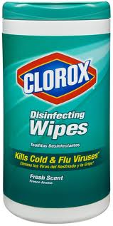
Cleaning and Disinfecting
Clean area before you begin work
Clean common touch points
Disinfect surfaces
Small rooms will have signs such that no more than one person should occupy that room at any given time.
Clean up work area after use.
Wear appropriate PPE

Slide 9
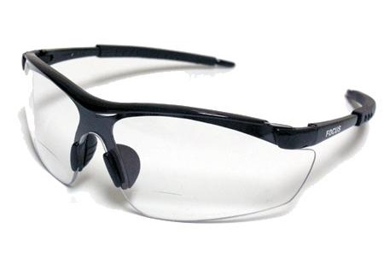
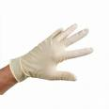
Controlling Habits
If you are not feeling well stay home, monitor your condition, and ask for help if you need it.
Cough/sneeze into one’s arms vs. into one’s hands
Avoid touching one’s face
Wear face coverings
Exercise hand hygiene - Wash your hands often.
Use hand sanitizers (but hands must be clean for sanitizers to work most effectively)
Clean and disinfect frequently touched objects and surfaces.
Use your own pens – do not share pens.
Clean the surface of your cell phones often
Use a paper towel or tissue to open doors
When using shared computers, use coverings for the keyboard and the computer mouse.
Do not use water foundations

Slide 10
What you are expected to do if exposed to COVID-19
Self-quarantine for 14 days
Monitor your temperature
Contact your health care provider
If you are experiencing difficulty breathing, go to the Emergency room
Contact your supervisor
If you test positive, there health department will contact your supervisor and will work to identify those who you have been in contact with.

Slide 11
Consequences for Not following Compliance
Expected Safety Protocols:
Reserving labs/instruments in advance of usage and following the calendar schedule
Following directional flow within the building
Use of face coverings
Not using elevator unless permitted
Showing up with symptoms (constant coughing, sneezing, runny nose)
Cleaning research area/instrument before and after use including computer keyboard and each computer mouse
Proper usage of gloves
Proper use and storage of lab coats
One violation will lead to a written warning
Two strikes – access will be revoked

Slide 12
Important Resources
World Health Organization
https://www.who.int/emergencies/diseases/novel-coronavirus-2019
Centers for Disease Control
https://www.cdc.gov/coronavirus/2019-ncov/index.html
North Carolina Department of Health and Human Services
https://covid19.ncdhhs.gov/
North Carolina Agricultural and Technical State University
https://www.ncat.edu/coronavirus/
University of North Carolina at Greensboro
https://update.uncg.edu/

